Slide 1

cv
An Optimized approach for Automatic left ventricle detection and Segmentation
Team Members
1. Anirudh P Kalghatkar -1DS19CS024
2. Darshan Sudheer Amadalli– 1DS19CS042
3. Uday D – 1DS19CS199
4. Shashank K – 1DS19CS201
Under the Guidance of
Dr . Kavitha K S
Professor, Dept of Computer Science and Engineering
Department of Computer Science & Engineering, DSCE

Slide 2
cv
ABSTRACT
In cardiac MRI, analysis of left ventricle is an initially quantified method to diagnose cardiac contractile function. A detailed understanding of the cardiac contractility is essential to diagnose, and treat heart-related disorders.
Therefore, segmentation of LV plays a crucial role in the prevention of the heart attacks, which is a common cause of death. Manual segmentation is a time-consuming job for both cardiologists.Also, it can lead to a high number of false positives due to human errors, such as fatigue and distractions. Therefore, a computer-aided diagnosis system is needed, which can assist to accurately segment LV boundaries in cardiac MRI
Department of Computer Science & Engineering, DSCE

Slide 3
cv
INTRODUCTION
In recent years, there has been an increased focus on the development of automatic methods for the detection and segmentation of the left ventricle (LV) in medical images. This is due in part to the growing prevalence of cardiovascular disease, as well as the need for more accurate and efficient methods for LV assessment.
There are a number of challenges associated with LV detection and segmentation, including the large variability in LV shape and size, as well as the presence of other structures such as the right ventricle (RV) and left atrium (LA) in the same images.
Department of Computer Science & Engineering, DSCE

Slide 4
cv
Additionally, the LV myocardium (the muscular wall of the heart) can often be obscured by other nearby structures, such as the ribs.
U-net is a neural network architecture designed primarily for image segmentation. The basic structure of a U-net architecture consists of two paths. The first path is the contracting path, also known as the encoder or the analysis path, which is similar to a regular convolution network and provides classification information. The second is an expansion path, also known as the decoder or the synthesis path, consisting of up-convolutions and concatenations with features from the contracting path. This expansion allows the network to learn localized classification information.
Additionally, the expansion path also increases the resolution of the output, which can then pass to a final convolutional layer to create a fully segmented image. The resulting network is almost symmetrical, giving it a u-like shape.
Department of Computer Science & Engineering, DSCE

Slide 5
cv
LITERATURE SURVEY
ELU-Net: An Efficient and Lightweight U-Net for Medical Image Segmentation
Introduction:
The most widely used medical imaging technique is image semantic segmentation, which is used in automatic segmentation and recognition of organs and lesions. Typical image semantic segmentation algorithms include FCN , SegNet , U-Net , PSPNet , series versions of Deeplab , DANet , etc. Among them, U-Net is more suitable for
The associate editor coordinating the review of this manuscript and approving it for publication was Donato Impedovo .medical segmentation tasks due to its unique architecture. A large number of researchers have made many improvements and attempts on this basis, and have achieved a series of gratifying achievements. For example, U-Net and its improved versions are used to separate out bladder cancer cells , predict skin lesions , and segment gallstones , liver, liver tumors, and brain tumor etc.
Department of Computer Science & Engineering, DSCE

Slide 6
cv
LITERATURE SURVEY
Results:
In this study, we proposed a novel ELU-Net with deep skip connections to make full use of the features from the encoder for realizing an efficient and lightweight segmentation network architecture. The Vgg16 and ResNet 34 backbone network with many loss functions and their combinations is found to give full play to the effect of our methods, and a new loss function with dice loss, focal loss and KL divergence loss, DFK, was designed based on the exponential and logarithmic advantages.
The experimental results obtained for brain tumor and liver datasets demonstrate the effectiveness and outstanding performance of the proposed ELU-Net architecture with fewer parameters. The ELU-Net with ResNet 34 and DFK show Dice coefficients of 93.498%, 86.023% and 81.779% for WT, TC and ET with an average value of 87.100% for the BraTS 2018 validation dataset, and a value of 97.365% for the ISBI LiTS 2017 validation dataset.
Department of Computer Science & Engineering, DSCE

Slide 7
cv
LITERATURE SURVEY
Recent Trends of Left and Right Ventricle Segmentation in Cardiac MRI Using Deep Learning
Introduction:
Depictions of right ventricular cavity (RVC), left ventricular myocardium (LVM) and left ventricular cavity (LVC) are common in clinical diagnoses of heart disease . Recently, there is now a public dataset that can be used by researchers to find out information about MRI images of the heart.
Currently, there are many studies conducted to overcome errors in the diagnosis of heart MRI images, such as: the region of interest (ROI) method uses a convolution network to determine the left ventricle (LV) , the Deep Convolutional Neural Network (CNN) approach to localize Left Ventricular (LV) in the heart MRI image .
Department of Computer Science & Engineering, DSCE

Slide 8
cv
Results:
ROI is done for both LV and RV localization. Localization with ROI is then used to enter segmentation. A deep learning approach with a variety of architectural variations can produce high accuracy. The CNN architecture layer determines the level of accuracy. Data augmentation is needed when the amount of input data is insufficient, but data augmentation can also cause overfitting, which reduces the level of accuracy.
The method proposed for segmenting and classifying cardiac MRI uses the ReLU layer on CNN networks with an accuracy of 97% to 98.66%.
A public dataset has been provided, including ACDC, MICCAI, Kaggle, and SCD. The selection of the dataset can be done according to the purpose of the experiment to be conducted. Most public dataset provide ground truth and labeling to get some goals, such as classification, identification, and also the measurement of cardiac MRI images.
Department of Computer Science & Engineering, DSCE

Slide 9
cv
PROBLEM STATEMENT
Heart failure is a significant public health concern in terms of prevalence,mortality rates, and economic burden.
The left ventricle connects nearly all organ systems through its function to pump oxygenated blood to the body. Left ventricular failure would likely result in impairment to all other organ systems.
Cardiac MRI is a non-invasive tool suitable for qualitative and quantitative assessment of cardiac anatomical structures and functions and provide support for diagnosis, disease monitoring, treatment planning, and prognosis.
Segmentation of the left ventricle in cardiac MRI images poses a challenge, where delineation of the endocardial borders is a time consuming and difficult task.
Department of Computer Science & Engineering, DSCE

Slide 10
cv
CHALLENGES
The most challenging part of this project is to find the optimal parameters for the segmentation model.
Another challenge is to improve the performance of the model on unseen data.
The Left Ventricle is highly variable shape ,making it difficult to define a consistent shape model.
The Left Ventricle is often surrounded by other structures such as the right ventricle,making it difficult to isolate in the image.
The Left Ventricle is often deformed in cardiac MRI sequences , making it difficult to segment using traditional image processing techniques.
Department of Computer Science & Engineering, DSCE

Slide 11
cv
OBJECTIVES
The aim of this study is to develop an optimized approach for automatic left ventricle detection and segmentation.
To evaluate the performance of the proposed approach in terms of accuracy, sensitivity, and specificity.
To compare the performance of the proposed approach with that of other existing methods.
Department of Computer Science & Engineering, DSCE

Slide 12
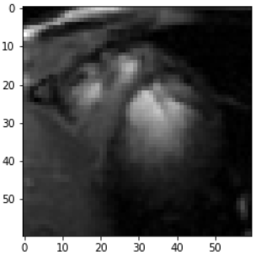
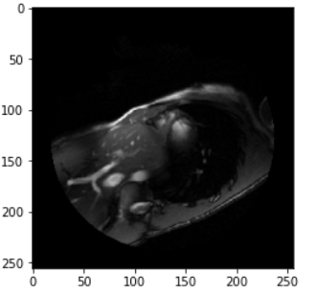
cv
INPUT:
The input to an ELU-Net for left ventricle segmentation would typically be a 3D medical image such as magnetic resonance imaging (MRI) scan.
Region Of Interest
Input MRI Image
Department of Computer Science & Engineering, DSCE
Department of Computer Science & Engineering, DSCE

Slide 13
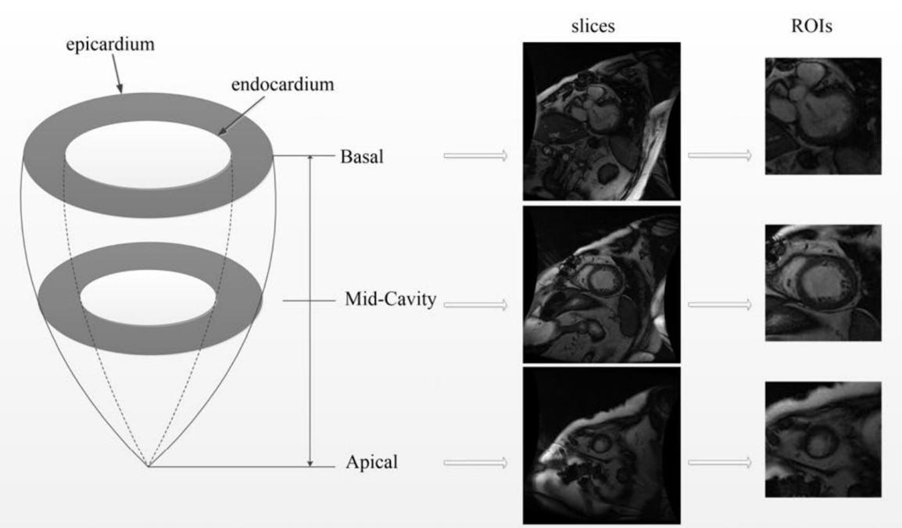
cv
METHODOLOGY
From the input image, the ROI( Region of interest), Since the given dataset may have the full MRI image.
It is necessary to ensure that the model does not end up with any unwanted information cropping the image is necessary. The input size of the data would be 110 x 110 pixels
Department of Computer Science & Engineering, DSCE

Slide 14
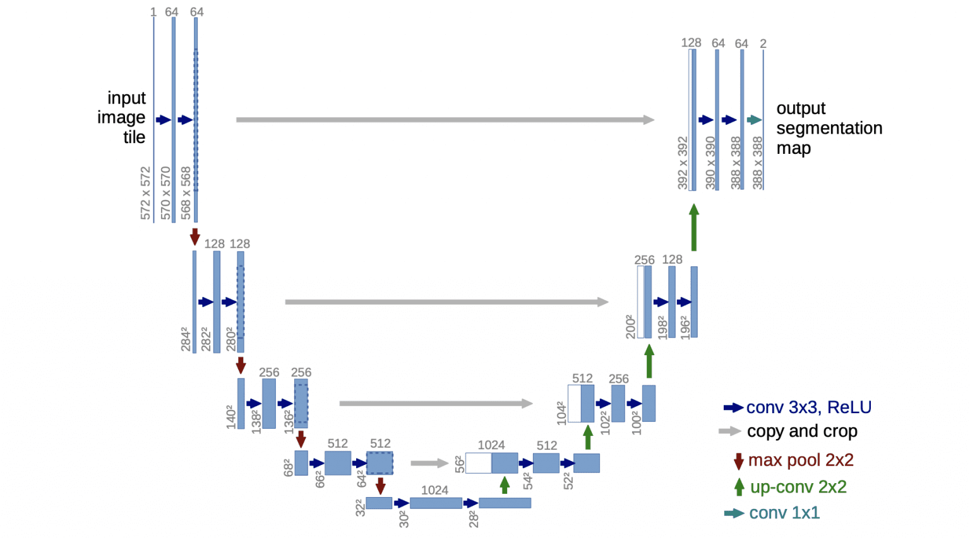
cv
METHODOLOGY
Basic U-Net Architecture
Department of Computer Science & Engineering, DSCE

Slide 15
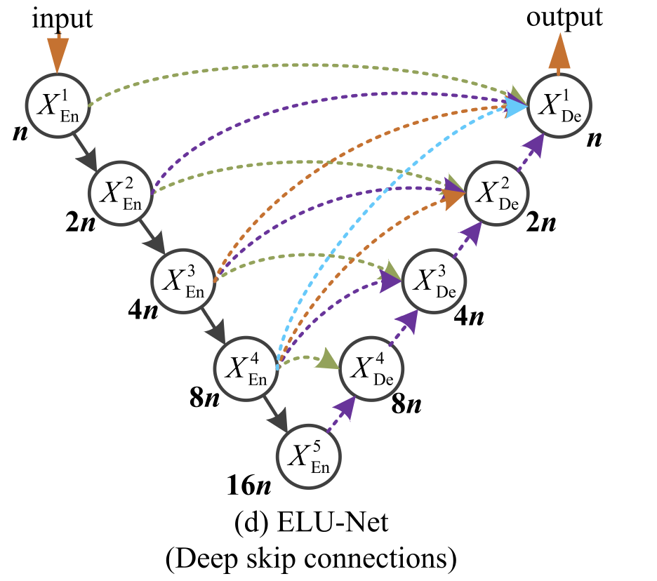
cv
A deep skip connection along with plain skip connection is utilised to fully extract the features .
ResNet34 Or Vgg16 can be used as the backbone of the network and is responsible for the encoder and decoder operation of the architecture.
The results of ELU-Net+ResNet34 & ELU-NET+Vgg16 performance will be compared.
Department of Computer Science & Engineering, DSCE

Slide 16

cv
Modules
Preprocessing module
Image segmentation module
post-processing module
Evaluation module
Department of Computer Science & Engineering, DSCE
Department of Computer Science & Engineering, DSCE

Slide 17
cv
Modules Description
Preprocessing module: This module involves preparing the medical images for segmentation by removing noise, correcting image artifacts, and enhancing contrast.
Image segmentation module: This module involves separating the left ventricle from the rest of the heart and other surrounding structures in the medical images.
post-processing module: This module involves refining the segmentation results by removing false positives, filling gaps, and smoothing the boundaries.
Evaluation module: This module involves comparing the segmentation results against ground truth data to measure the accuracy of the segmentation algorithm.
Department of Computer Science & Engineering, DSCE
Department of Computer Science & Engineering, DSCE

Slide 18
cv
PREPROCESSING:
The preprocessing steps for left ventricle segmentation using ELU-net typically involve the following:
Data preparation: Collecting and organizing the data for training and testing the ELU-net model. This includes obtaining medical images of the left ventricle, such as MRI , and associated labels for segmentation.
Data augmentation: Generating additional training data by applying various transformations to the original images. This can include rotations, scaling, flipping, and changing the brightness and contrast of the images.
Intensity normalization: Scaling the image intensities to a common range, such as [0, 1] or [-1, 1], to facilitate training of the ELU-net model.
Department of Computer Science & Engineering, DSCE
Department of Computer Science & Engineering, DSCE

Slide 19
cv
PREPROCESSING:
4. Image resizing: Resizing the images to a fixed size to ensure that they are compatible with the ELU-net model architecture.
5. Patch extraction: Dividing the images into smaller patches reduces the ELU-net model's memory requirements and facilitates training.
6. Patch normalization: Applying patch-based normalization techniques, such as local contrast normalization or Z-score normalization, to further enhance the contrast and reduce variability across different patches.
7. Label processing: Preparing the labels for training the ELU-net model. This can involve one-hot encoding, where each pixel in the label is represented as a binary vector, or applying morphological operations to refine the segmentation mask.
Department of Computer Science & Engineering, DSCE
Department of Computer Science & Engineering, DSCE

Slide 20
cv
ALGORITHM:
ELU-net is a deep learning architecture used for image segmentation tasks. It utilizes the Exponential Linear Unit (ELU) activation function, which is a variant of the Rectified Linear Unit (ReLU) activation function. The algorithm for left ventricle segmentation using ELU-net can be summarized in the following steps:
Pre-processing: The input image is pre-processed by resizing it to a standard size and normalizing the pixel values.
ELU-net Architecture: The ELU-net architecture is a convolutional neural network (CNN) that consists of multiple layers, including convolutional layers, pooling layers, and fully connected layers.
Department of Computer Science & Engineering, DSCE
Department of Computer Science & Engineering, DSCE

Slide 21
cv
ALGORITHM :
Training: The ELU-net is trained using a large dataset of images with their corresponding ground truth segmentation masks. The loss function used during training is usually the dice loss or cross-entropy loss.
Prediction: Once the ELU-net is trained, it can be used to predict the segmentation mask for a new input image.
Post-processing: The predicted segmentation mask is post-processed to remove any noise or artifacts using techniques such as morphological operations or connected component analysis.
Department of Computer Science & Engineering, DSCE

Slide 22
cv
ALGORITHM:
In the case of left ventricle segmentation, the ELU-net is trained using a dataset of cardiac MRI images with corresponding ground truth segmentation masks of the left ventricle. The trained model is then used to predict the segmentation mask for new cardiac MRI images, which can be used for various clinical applications, such as diagnosis and treatment planning
Department of Computer Science & Engineering, DSCE

Slide 23
cv
Co-Guide Meet Details
10th Jan 2023: Suggested to collect more dataset
14th Feb 2023: Showed the collected dataset from the website ACDC
10th May 2023:Showed the progress of project , and discussed how the further progression of project may take place and when the project will get over
Department of Computer Science & Engineering, DSCE
Department of Computer Science & Engineering, DSCE

Slide 24
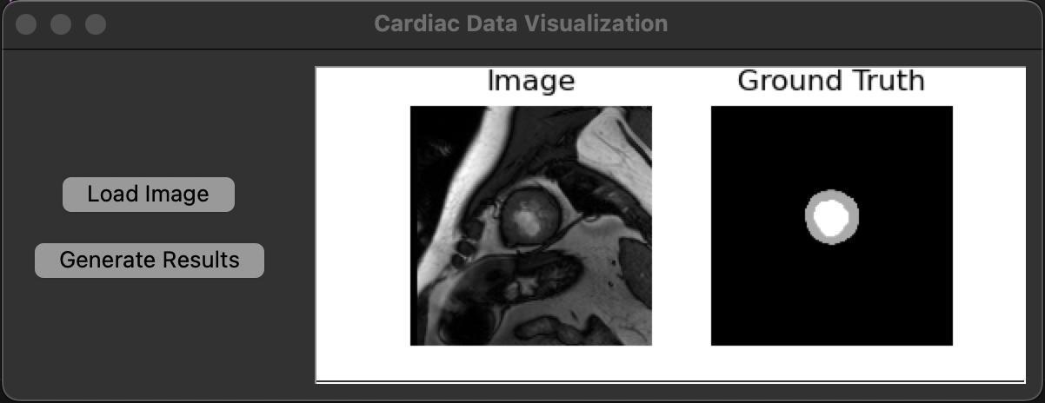
cv
OUTPUT:
Department of Computer Science & Engineering, DSCE
Department of Computer Science & Engineering, DSCE

Slide 25
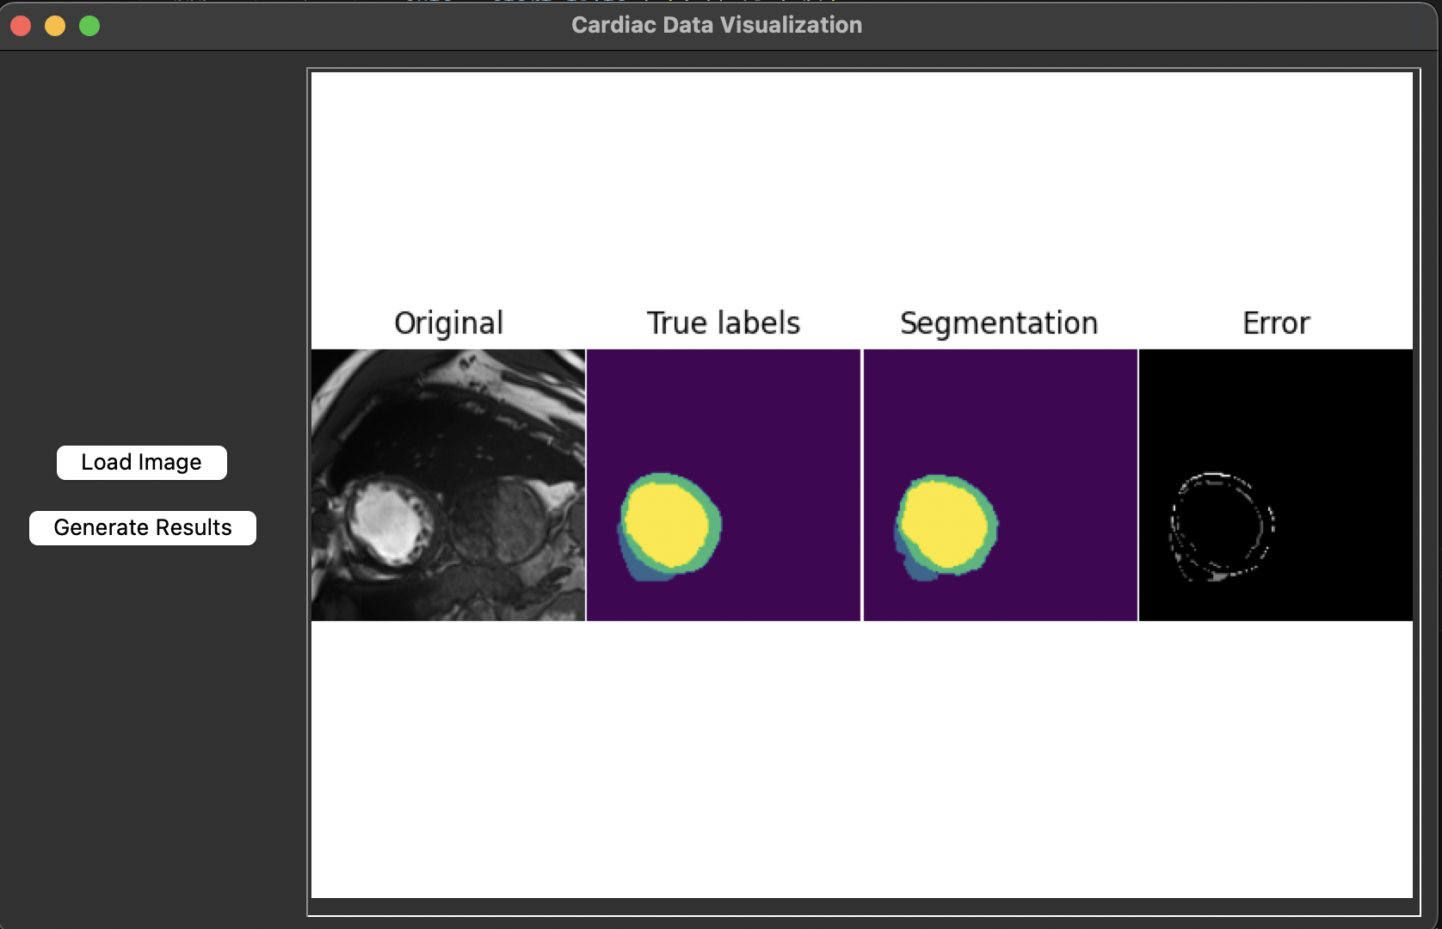
cv
OUTPUT:
Department of Computer Science & Engineering, DSCE
Department of Computer Science & Engineering, DSCE

Slide 26
cv
APPLICATION
Medical imaging, including volume rendered images from computed tomography and magnetic resonance imaging.
Locate tumors and other pathologies
Measure tissue volumes
Diagnosis, study of anatomical structure
Surgery planning
Virtual surgery simulation
Intra-surgery navigation
Object detection
Pedestrian detection
Face detection
Brake light detection
Locate objects in satellite images (roads, forests, crops, etc.)
Department of Computer Science & Engineering, DSCE

Slide 27
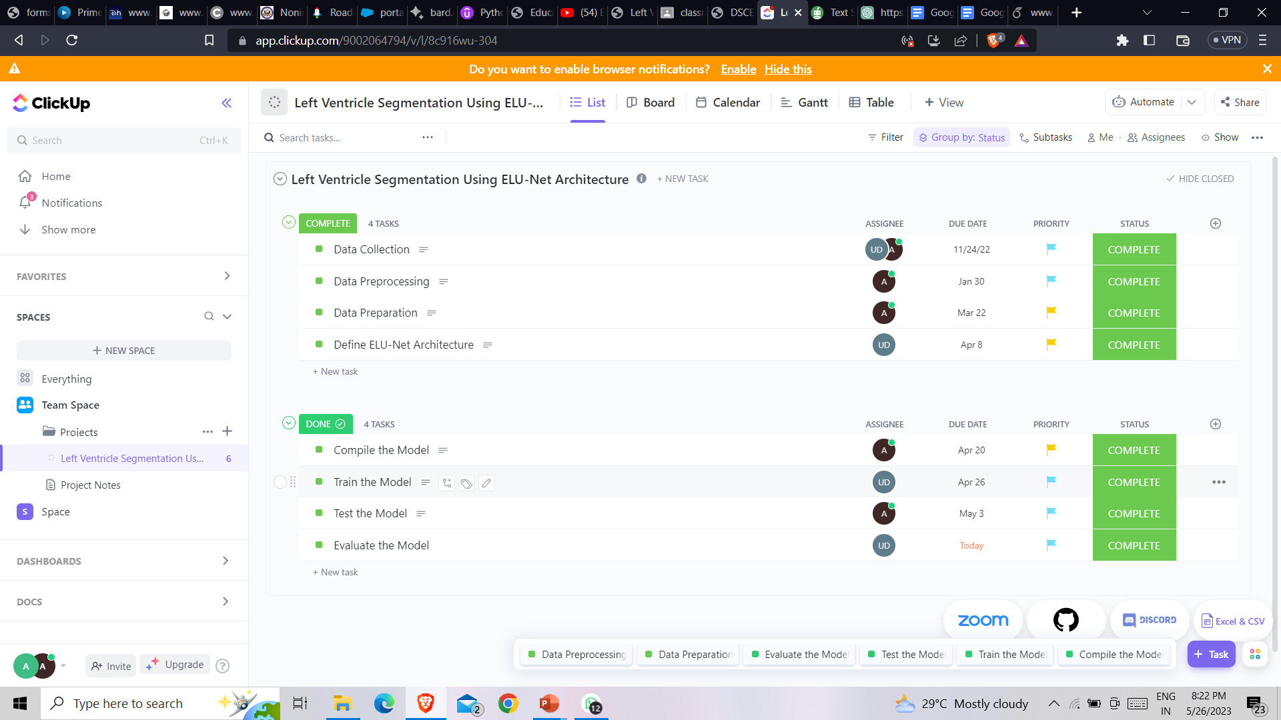
cv
Department of Computer Science & Engineering, DSCE

Slide 28
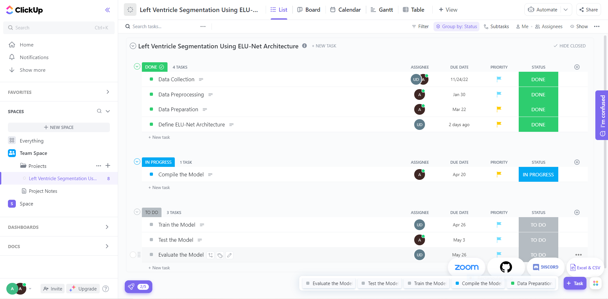
cv
PROJECT TOOL SNAPSHOT:
Department of Computer Science & Engineering, DSCE
Department of Computer Science & Engineering, DSCE

Slide 29
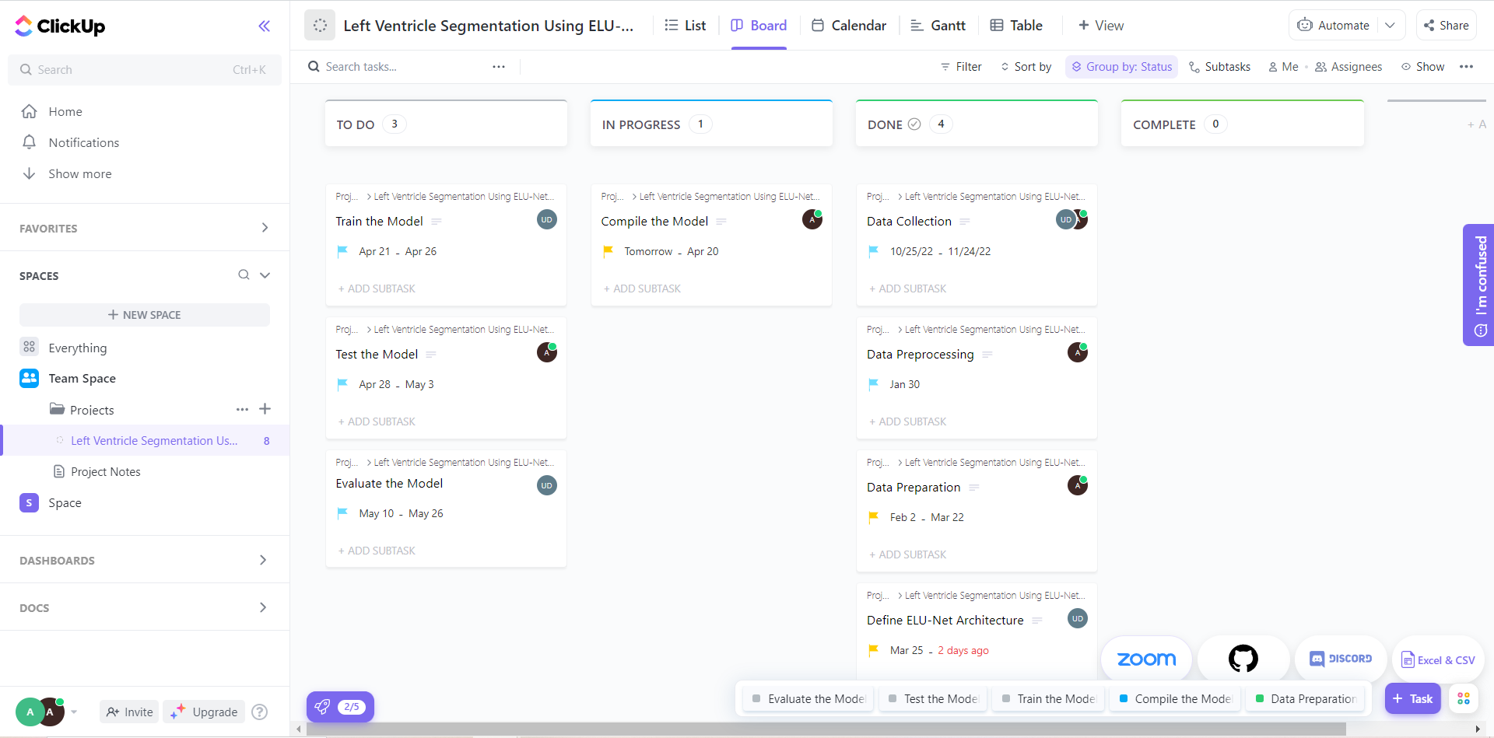
cv
Department of Computer Science & Engineering, DSCE

Slide 30
cv
Contribution of each project members
Student Name | Contribution
Anirudh Prashant Kalghatkar | Model Generation
Darshan Sudheer Amadalli | Data Preprocessing
Uday D | Model Generation
Shashank K | Data Collection
Department of Computer Science & Engineering, DSCE
Department of Computer Science & Engineering, DSCE

Slide 31
cv
REFERENCES
[1]S. Charmchi, K. Punithakumar and P. Boulanger, "Optimizing U-Net to Segment Left Ventricle from Magnetic Resonance Imaging," 2018 IEEE International Conference on Bioinformatics and Biomedicine (BIBM), 2018, pp. 327-332, doi: 10.1109/BIBM.2018.8621552.
[2]Sun, Xiaowu et al. “SAUN: Stack attention U-Net for left ventricle segmentation from cardiac cine magnetic resonance imaging.” Medical physics vol. 48,4 (2021): 1750-1763. doi:10.1002/mp.14752
[3]Y. Deng, Y. Hou, J. Yan and D. Zeng, "ELU-Net: An Efficient and Lightweight U-Net for Medical Image Segmentation," in IEEE Access, vol. 10, pp. 35932-35941, 2022, doi: 10.1109/ACCESS.2022.3163711.
[4]U-Net and Its Variants for Medical Image Segmentation: A Review of Theory and Applications
[5]Y. Weng, T. Zhou, Y. Li and X. Qiu, "NAS-Unet: Neural Architecture Search for Medical Image Segmentation," in IEEE Access, vol. 7, pp. 44247-44257, 2019, doi: 10.1109/ACCESS.2019.2908991.
[6]M. H. Jafari et al., "Semi-Supervised Learning For Cardiac Left Ventricle Segmentation Using Conditional Deep Generative Models as Prior," 2019 IEEE 16th International Symposium on Biomedical Imaging (ISBI 2019), 2019, pp. 649-652, doi: 10.1109/ISBI.2019.8759292.
[7]V. Zyuzin and T. Chumarnaya, "Comparison of Unet architectures for segmentation of the left ventricle endocardial border on two-dimensional ultrasound images," 2019 Ural Symposium on Biomedical Engineering, Radioelectronics and Information Technology (USBEREIT), 2019, pp. 110-113, doi: 10.1109/USBEREIT.2019.8736616.
[8]A. Amer, X. Ye and F. Janan, "ResDUnet: A Deep Learning-Based Left Ventricle Segmentation Method for Echocardiography," in IEEE Access, vol. 9, pp. 159755-159763, 2021, doi: 10.1109/ACCESS.2021.3122256.
[9] O. Ronneberger, P. Fischer, and T. Brox, ‘‘U-Net: Convolutional networks for biomedical image segmentation,’’ in Proc. Int. Conf. Med. Image Comput.-Assist. Intervent., 2015, pp. 234–241
[10] P. Ahmad, H. Jin, R. Alroobaea, S. Qamar, R. Zheng, F. Alnajjar, and F. Aboudi, ‘‘MH UNet: A multi-scale hierarchical based architecture for medical image segmentation,’’ IEEE Access, vol. 9, pp. 148384–148408, 2021.
Department of Computer Science & Engineering, DSCE

Slide 32
cv
THANK YOU!
Department of Computer Science & Engineering, DSCE
Department of Computer Science & Engineering, DSCE

